Slide 1

Mechanisms underlying the predator-prey diversity relationships in marine bacterioplankton – implications from the community assembly processes
Feng-Hsun Oscar Chang
@ IONTU 422 lab meeting

Slide 2
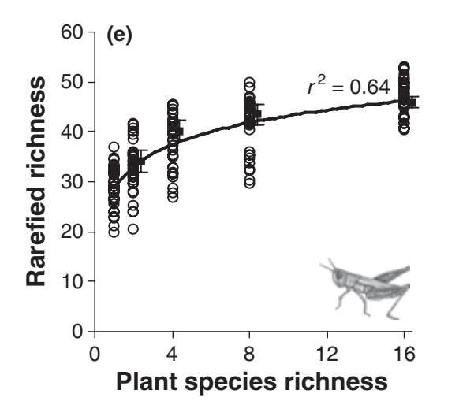
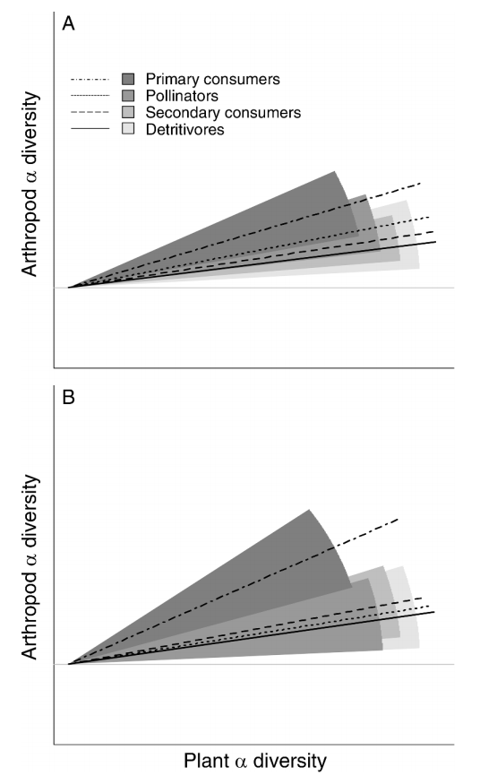
Haddad et al. 2009 @ Eco. Lett.
Castagneyrol et al. 2012 @ Ecology

Slide 3
Why the diversity of predator and prey are positively associated?
+
Predator
diversity
Prey
diversity

Slide 4
+
Predator
diversity
Prey
diversity
could be…
Predator
diversity
Prey
diversity
+/-
+/-
Confounding
factors

Slide 5
+
Predator
diversity
Prey
diversity
could be…
+
Predator
diversity
Prey
diversity
+/-
+/-
Confounding
factors

Slide 6
+
Predator
diversity
Prey
diversity
could be…
+
Predator
diversity
Prey
diversity
+
+/-
+/-
Confounding
factors

Slide 7
Can community assembly processes help?
Ecological community
Patterns
Species-area relationships
Diversity gradients
Relative abundance distributions
etc…
Community
assembly processes
Vellend 2010 @ Q. Rev. Biol.

Slide 8
Can community assembly processes help?
Ecological community
Patterns
Species-area relationships
Diversity gradients
Relative abundance distributions
etc…
Drift
Selection
Speciation
Dispersal
Vellend 2010 @ Q. Rev. Biol.

Slide 9
Can community assembly processes help?
Ecological community
Random /
Stochasticity
Patterns
Species-area relationships
Diversity gradients
Relative abundance distributions
etc…
Drift
Selection
Speciation
Dispersal
Vellend 2010 @ Q. Rev. Biol.

Slide 10
Can community assembly processes help?
Ecological community
Random /
Stochasticity
Patterns
Species-area relationships
Diversity gradients
Relative abundance distributions
etc…
Drift
Selection
Speciation
Dispersal
Non-random /
Deterministic
Vellend 2010 @ Q. Rev. Biol.

Slide 11
Can community assembly processes help?
Ecological community
Random /
Stochasticity
Patterns
Species-area relationships
Diversity gradients
Relative abundance distributions
etc…
Drift
Selection
Speciation
Dispersal
Non-random /
Deterministic
Both ???
Vellend 2010 @ Q. Rev. Biol.

Slide 12
+
Predator
diversity
Prey
diversity
decompose
Predator
diversity
Prey
diversity
Deterministic assembly processes
of predator community
Deterministic assembly processes
of prey community

Slide 13
Divergent
assembly processes
Homogeneous
assembly processes

Slide 14
Species pool
Homogeneous
assembly processes
Divergent
assembly processes
Local community
Local community
Low α diversity
High α diversity

Slide 15
Species pool
Homogeneous
assembly processes
Divergent
assembly processes
Local communities
Local communities
Low β diversity
High β diversity

Slide 16
Predator (prey) diversity increases the divergent assembly processes of prey (predator) community, which in turn increase prey (predator) diversity, in both α and β levels
Predator
diversity
Prey
diversity
+
+
+
+
Divergent assembly processes of predator community
Divergent assembly processes of prey community

Slide 17
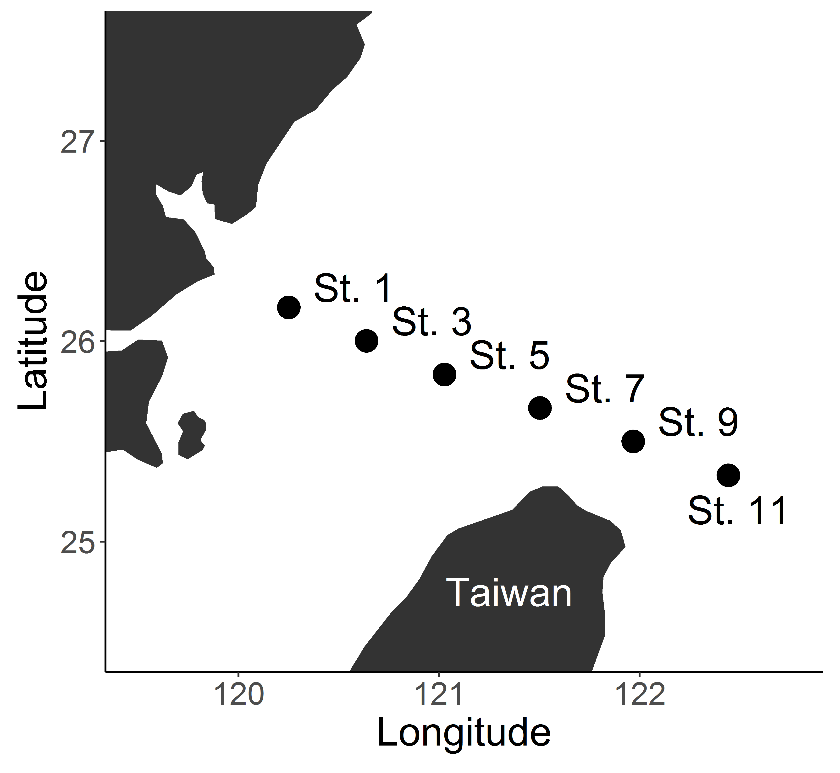
- 14 cruises - Predator: Heterotrophic nano-flagellates (HNF; 18S rDNA) - Prey: Bacteria (16S rDNA)

Slide 18
Deterministic assembly processes: Mean Pairwise Taxa Index (MPTI), calculated from mean pairwise phylogenetic distance
αMPTI
Community
Observed
distance
Null mean
Null distribution of
mean pairwise distance

Slide 19
Deterministic assembly processes: Mean Pairwise Taxa Index (MPTI), calculated from mean pairwise phylogenetic distance
βMPTI
Community 1
Community 2
Observed
distance
Null mean
Null distribution of
mean pairwise distance

Slide 20
Deterministic assembly processes: Mean Pairwise Taxa Index (MPTI)
More
negative MPTI
More
positive MPTI
Null mean
Stronger
homogeneous
assembly processes
Stronger
divergent
assembly processes
Null distribution of
mean pairwise distance

Slide 21
HNF
diversity
Bacteria
diversity
+
+
+
+
MPTI of HNF community
MPTI of bacteria community
Divergent
assembly processes of
Bacteria (HNF) community
Bacteria (HNF) diversity
HNF (Bacteria) diversity
Divergent assembly processes
of Bacteria (HNF) community

Slide 22
In α level…

Slide 23
In α level…
HNF
diversity
Bacteria
diversity
αMPTI of HNF community
αMPTI of bacteria community

Slide 24
In α level…
HNF
diversity
+
Bacteria
diversity
+
αMPTI of HNF community
αMPTI of bacteria community

Slide 25
HNF diversity
HNF diversity
Bacteria diversity
Bacteria diversity
Stronger divergent processes
Tighter association (larger R²) ?

Slide 26
HNF diversity
HNF diversity
Bacteria diversity
Bacteria diversity
Stronger divergent processes
Larger diversity effects (larger regression coefficient) ?

Slide 27
In α level…
Stronger divergent processes ≠> Tighter association (larger R²)

Slide 28
In α level…
Stronger divergent processes =? Larger diversity effects (larger regression coefficient)

Slide 29
In α level…
HNF
diversity
Bacteria
diversity
+
+
MPTI of HNF community
MPTI of bacteria community

Slide 30
In β level… - Chao similarity - mean pairwise similarity within a cruise

Slide 31
In β level…

Slide 32
In β level…
HNF
diversity
+
Bacteria
diversity
+
MPTI of HNF community
MPTI of bacteria community

Slide 33
In β level…
HNF
diversity
HNF
diversity
Bacteria
diversity
+
+
Bacteria
diversity
+
+
MPTI of HNF community
MPTI of HNF community
MPTI of bacteria community
MPTI of bacteria community

Slide 34
In β level…
Stronger divergent processes ≠> Tighter association (larger R²)

Slide 35
In β level…
Stronger divergent processes ≠> Larger diversity effects (larger regression coefficient)

Slide 36
In α level…
HNF
diversity
Bacteria
diversity
+
+
MPTI of HNF community
MPTI of bacteria community
In β level…
HNF
diversity
Bacteria
diversity
+
+
+
+
MPTI of HNF community
MPTI of bacteria community

Slide 37
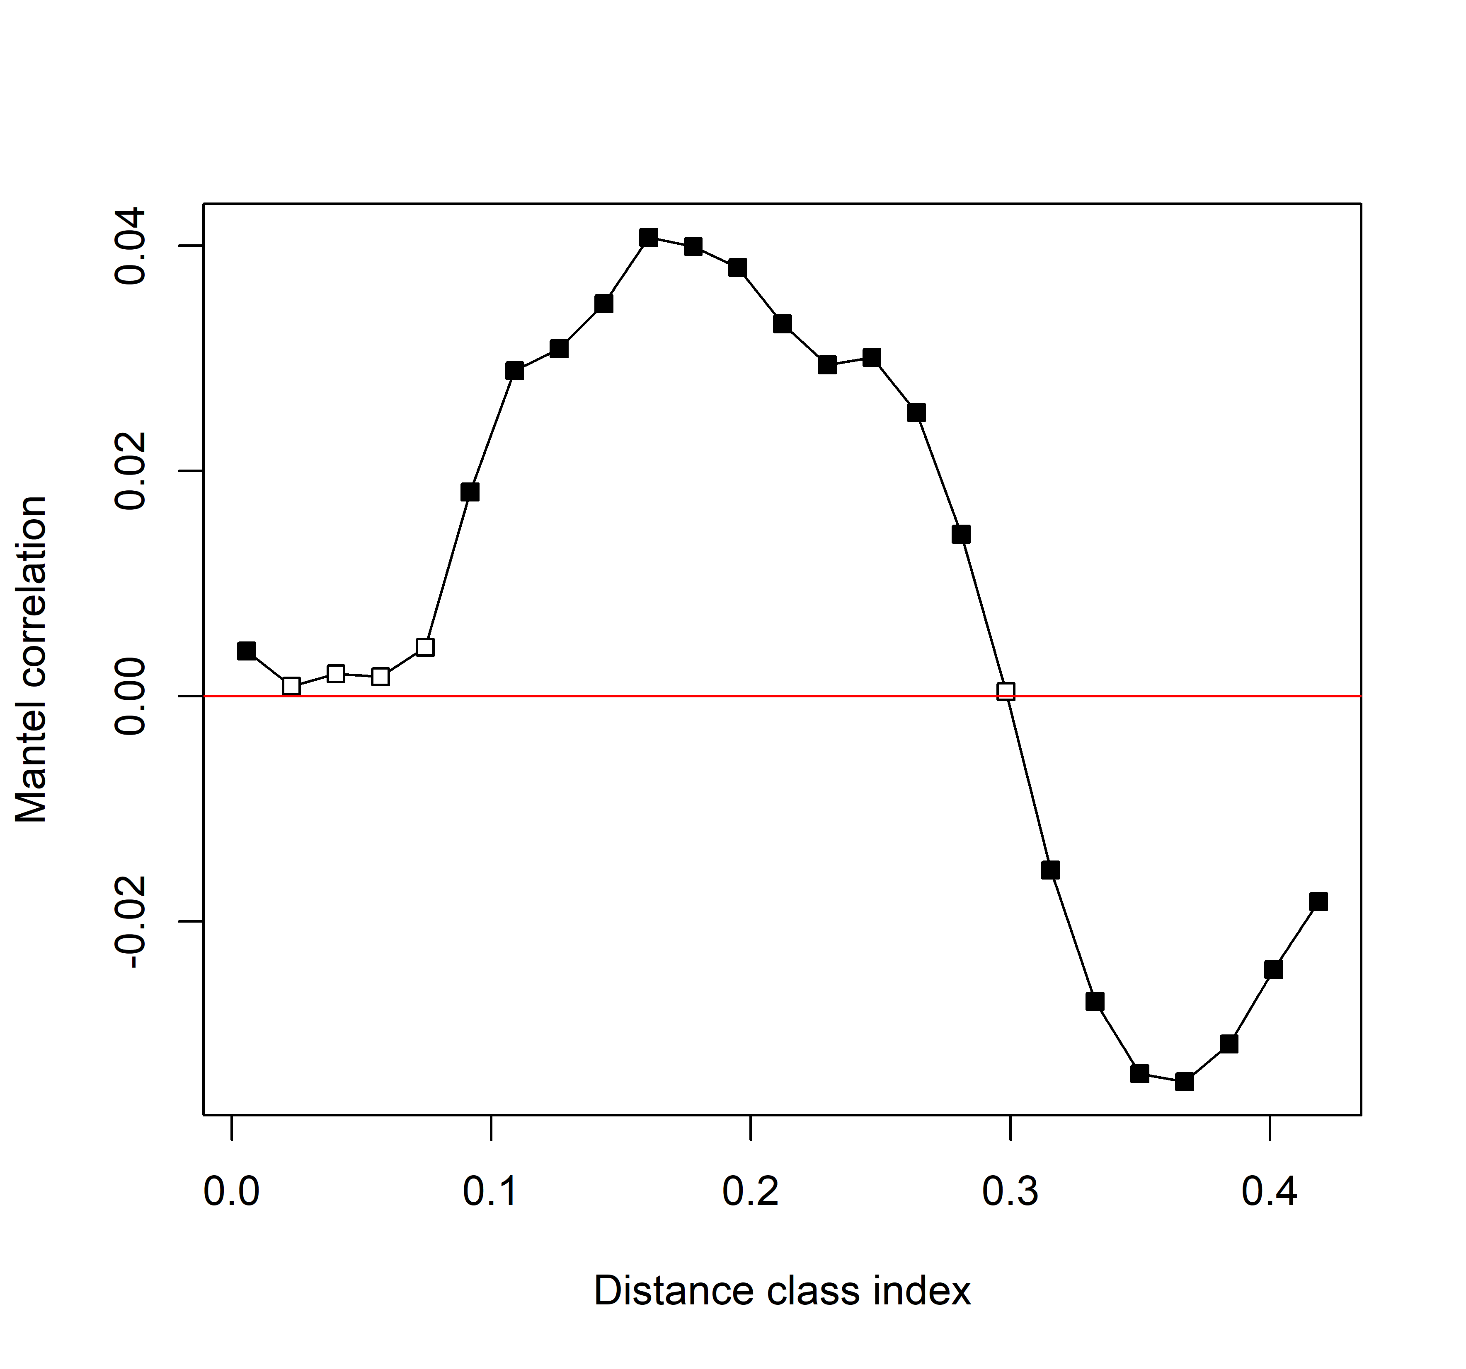
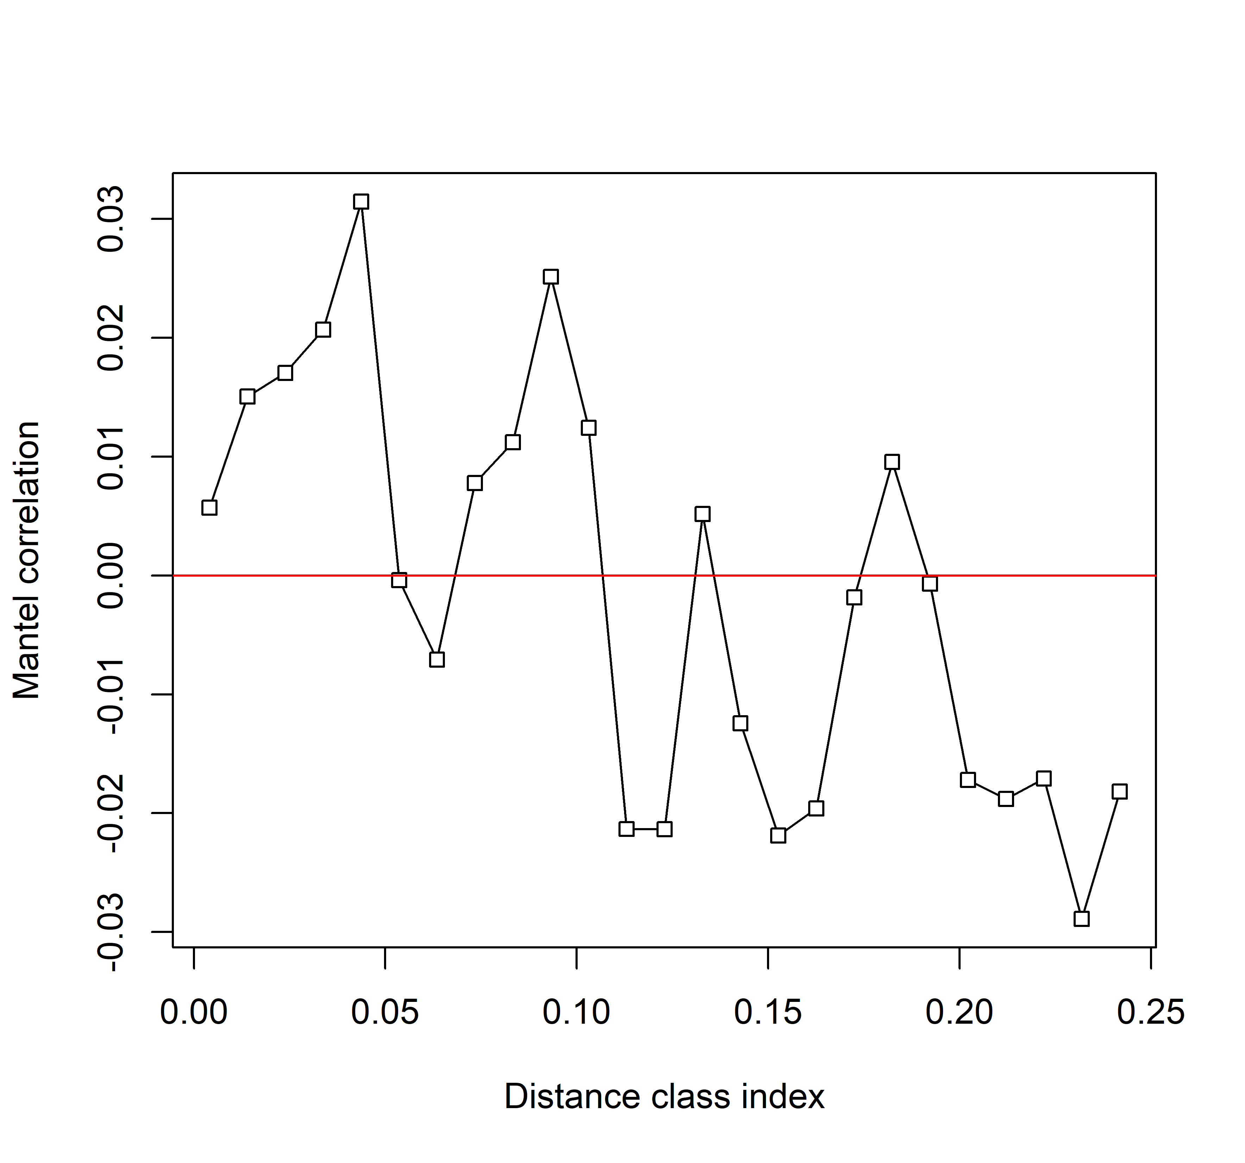
Things remain unclear… - Reliability of phylogenetic signal / niche conservatism?

Slide 38
Things remain unclear… - Reliability of phylogenetic signal / niche conservatism? - Tighter association or stronger diversity effects?

Slide 39
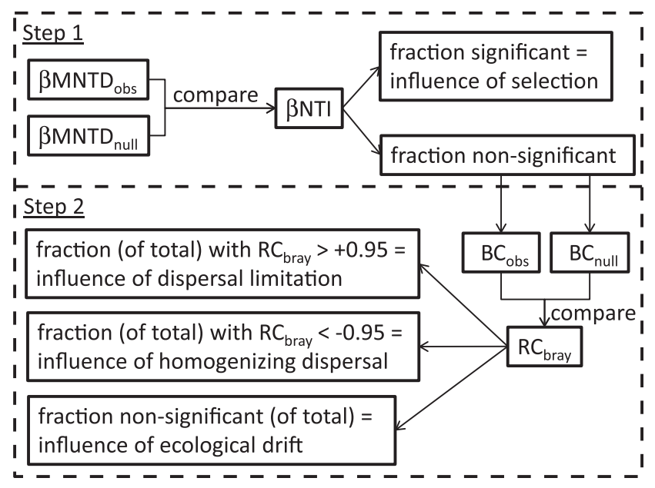
Things remain unclear… - Reliability of phylogenetic signal / niche conservatism? - Tighter association or stronger diversity effects? - How to quantify dispersal? Or, is it necessary to do so?
Phylogenetic distance
=> Selection/Speciation
Ecological distance (e.g. Chao, Bray-Curtis…)
=> Dispersal
Stegen 2013 et al. @ ISME

Slide 40
Things remain unclear… - Reliability of phylogenetic signal / niche conservatism? - Tighter association or stronger diversity effects? - How to quantify dispersal? Or, is it necessary to do so?
Stegen 2013 et al. @ ISME

Slide 41
Thank you. All comments are welcome!

